Slide 1


Betty Schrampfer Azar
Stacy A. Hagen
Teacher Resource Disc
Slide shows for use with
PowerPoint presentation software
Laurette Poulos Simmons
Copyright © 2007 by Pearson Education, Inc.
All rights reserved.

Slide 2

CONTENTS
8-1 Using be: past time
8-2 Past of be: negative
8-3 Past of be: questions
8-4 The simple past tense: using -ed
8-5 Past time words: yesterday, last, and ago
8-6 The simple past: irregular verbs (Group 1)
8-7 The simple past: negative
8-8 The simple past: yes/no questions
8-9 Irregular verbs (Group 2)
8-10 Irregular verbs (Group 3)
8-11 Irregular verbs (Group 4)

Slide 3
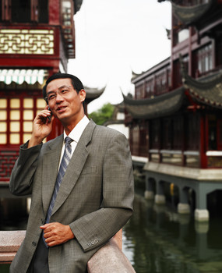
8-5 Let’s Practice
I called you ________ week.
last
yesterday
last

Slide 4
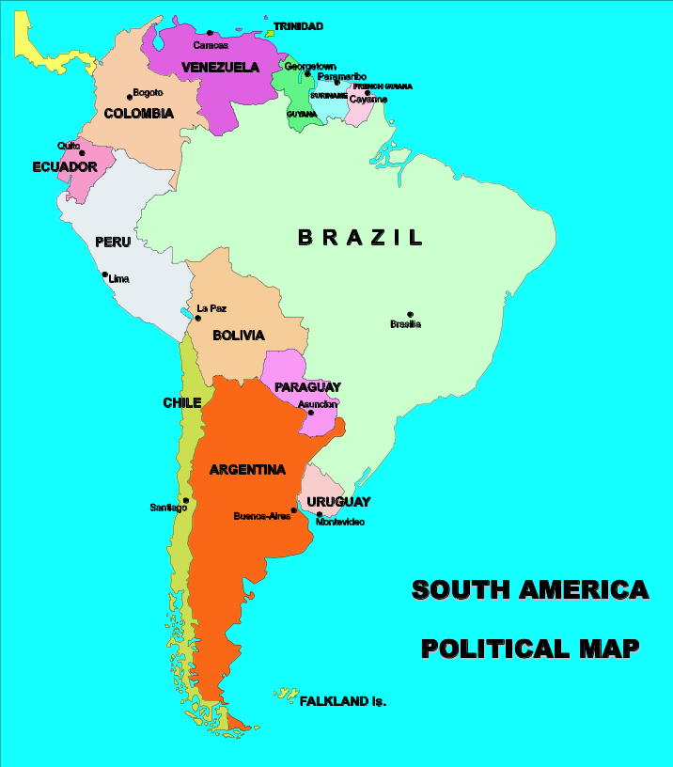
8-5 Let’s Practice
Janice left for South America
________ morning.
yesterday
yesterday
last

Slide 5
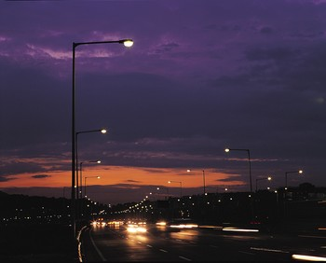
8-5 Let’s Practice
The sky was beautiful ______ night.
last
yesterday
last

Slide 6
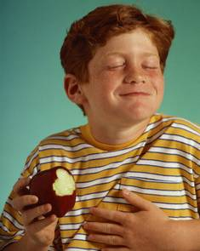
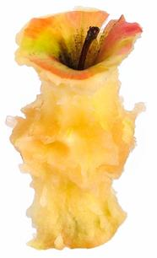
8-6 THE SIMPLE PAST: IRREGULAR VERBS (GROUP 1)
eat
ate

Slide 7
8-6 THE SIMPLE PAST: IRREGULAR VERBS (GROUP 1)
PRESENT PAST
come came
I come home
every afternoon.
I came home
this afternoon.

Slide 8
8-6 THE SIMPLE PAST: IRREGULAR VERBS (GROUP 1)
PRESENT PAST
go went
I went swimming
last Tuesday.
I go swimming
every Tuesday.

Slide 9
8-6 THE SIMPLE PAST: IRREGULAR VERBS (GROUP 1)
PRESENT PAST
write wrote
I wrote a letter
to her last week.
I write a letter to
my grandmother
every week.

Slide 10
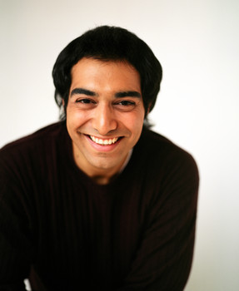
8-6 Let’s Practice
I have ice cream every Sunday. I had ice cream last Sunday.

Slide 11
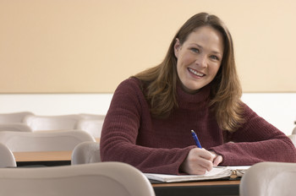
8-6 Let’s Practice
What did I do last
Sunday?
have
had
had
You ___
ice cream.

Slide 12
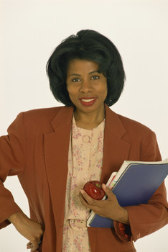
8-6 Let’s Practice
She sits at her desk to study every night. She sat at her desk last night.

Slide 13
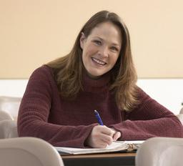
8-6 Let’s Practice
What did she do last night?
She ___ at her desk.
sit
sat
sat

Slide 14
8-6 Let’s Practice
She sees her best friend every weekend. She saw her last weekend.

Slide 15
8-6 Let’s Practice
What did she do last weekend?
She ____ her
best friend.
saw
see
saw

Slide 16
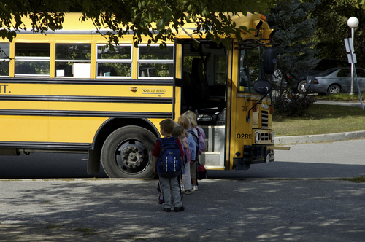
8-7 THE SIMPLE PAST: NEGATIVE
I did not walk to school yesterday.

Slide 17
8-7 THE SIMPLE PAST: NEGATIVE
(e) I didn’t watch a movie last night.
(f) Ade didn’t play soccer yesterday.
NEGATIVE CONTRACTION
did + not = didn’t

Slide 18
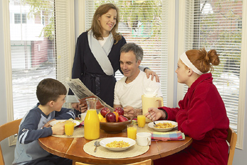
8-7 Let’s Practice
We don’t eat breakfast every day.
We ate breakfast Monday, but we ________ breakfast Tuesday.
didn’t eat

Slide 19
8-7 Let’s Practice
I don’t sleep well every night. I slept
well last night, but I __________ well
on Thursday night.
didn’t sleep

Slide 20
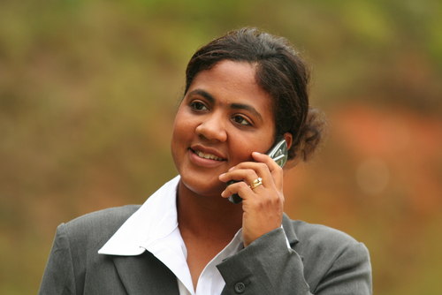
8-8 THE SIMPLE PAST: YES/NO QUESTIONS
Did Laurie walk to work?

Slide 21
8-8 THE SIMPLE PAST: YES/NO QUESTIONS
DID + SUBJECT + MAIN VERB
(a) Did Laurie walk to work?
Yes, she did.
She walked to work.

Slide 22
8-8 THE SIMPLE PAST: YES/NO QUESTIONS
DID + SUBJECT + MAIN VERB
(a) Did Laurie walk to school?
No, she didn’t.
She didn’t walk to school.

Slide 23
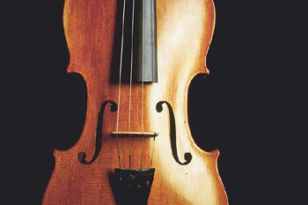
8-8 THE SIMPLE PAST: YES/NO QUESTIONS
DID + SUBJECT + MAIN VERB
(b) Did you practice the violin?
Yes, I did.
I practiced the violin.

Slide 24
8-8 THE SIMPLE PAST: YES/NO QUESTIONS
DID + SUBJECT + MAIN VERB
(b) Did you practice the violin?
No, I didn’t.
I didn’t practice the violin.

Slide 25
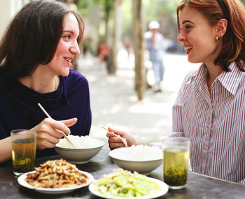
8-8 Let’s Practice
Did you see your dad today?
Yes, I did.
I saw my
dad today
_________________.

Slide 26
8-8 Let’s Practice
Did you see your brother today
Yes, I did.
I saw my
brother today.
_________________________?

Slide 27
8-8 Let’s Practice
did you
do last night
_____________________?
What
We went to a party last night.

Slide 28
8-8 Let’s Practice
Did Andrea go
on vacation
Yes, she did. Andrea went on
vacation.
_____________________?

Slide 29
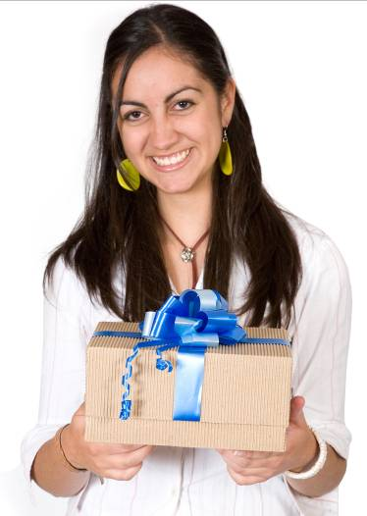
8-9 IRREGULAR VERBS (GROUP 2)
bring
brought

Slide 30
8-9 IRREGULAR VERBS (GROUP 2)
PRESENT PAST
run ran
He runs to
school.
He ran to school
this morning.

Slide 31
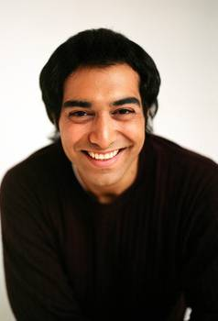
8-9 Let’s Practice
I _____ a class every Monday night. I ______ a class last Monday night.
teach
taught
teach
taught

Slide 32
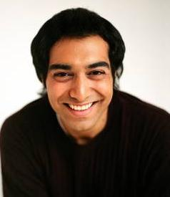
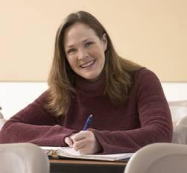
8-9 Let’s Practice
What did I do last Monday?
You taught a
class
_________________.
teach
taught

Slide 33
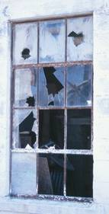
8-10 IRREGULAR VERBS (GROUP 3)
Someone broke the window.

Slide 34
8-10 IRREGULAR VERBS (GROUP 3)
PRESENT PAST
break broke
That child breaks
everything.
She broke my
coffee cup.

Slide 35
8-10 IRREGULAR VERBS (GROUP 3)
PRESENT PAST
meet met
I can meet you
after school.
They met in their
English class.

Slide 36
8-10 IRREGULAR VERBS (GROUP 3)
PRESENT PAST
sing sang
I like to sing
new songs.
I sang a new song
last night.

Slide 37
8-10 IRREGULAR VERBS (GROUP 3)
PRESENT PAST
wake up woke up
Sometimes I wake
up very early.
Today I woke
up late.

Slide 38
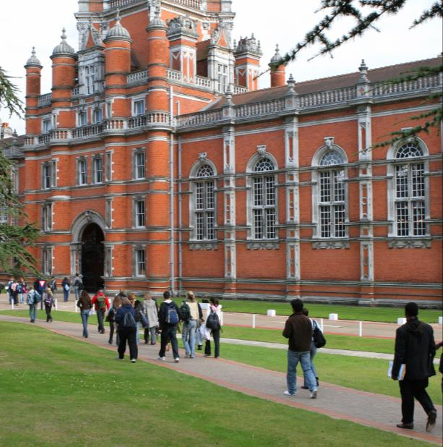
8-11 IRREGULAR VERBS (GROUP 4)
begin
began

Slide 39
8-11 IRREGULAR VERBS (GROUP 4)
PRESENT PAST
begin began
She began college
at age 25.
People usually
begin college at
age 18.

Slide 40
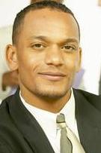
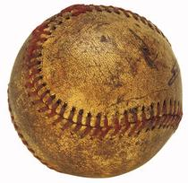
8-11 Let’s Practice
I like to ____ things I don’t use any more. Yesterday I ____ my old baseball.
sell
sold
sell
sold

Slide 41
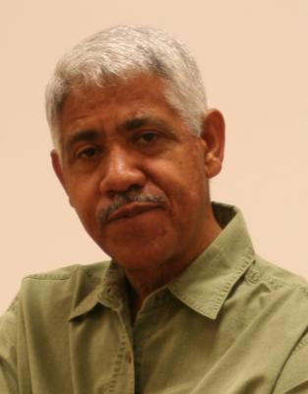
8-11 Let’s Practice
What did I do yesterday?
_____________________.
You sold your
old baseball
sell
sold

